Slide 1

Presented by:
Yang LIU 116010151 Xuansu ZHANG 116010301
Zhiyi ZHANG 116010308
Jingxuan QIU 116010181
Bombing Adventure

Slide 2
contents
01
Background
Yang LIU
What shall we do?
Problem
02
Xuansu ZHANG
What are the problems to solve?
03
Solution
Zhiyi ZHANG
Modern Interface, Level Design, and Network-based Multiplayer
Implementation and Planning
04
Jingxuan QIU
Implementation method and Milestone

Slide 3

01
Background
What is Bomberman?
What are we going to do?

Slide 4
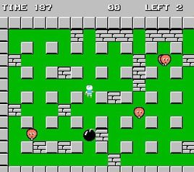
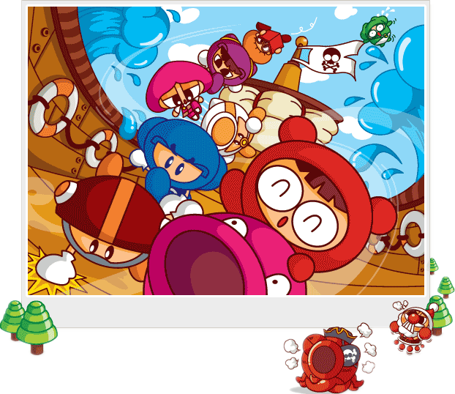
What is Bomberman?
Our
CSC3002
Project
in 2018
First developed in 1983, by Hudson Soft.
Crazy Arcade
Enter the China market in 2003.

Slide 5
02
Problem
Why it is boring now?

Slide 6



What is the shortage of the original?
NO Change
NO Challenge
NO Cooperation
Maze is onefold
AI is too young
Maze is too simple
Can’t play with friends
Notes:
As a classicial video game, Bomberman has a long history. However, comparaing current video games, the past versions of Bomberman are pretty boring.
Firstly, it is changeless. The mazes are similar and simple, and players will lose interest easily. Beside Dark Soul players, who want play at a single map again and again? .
Secondly, it is not challenging. This game does not has powerful evil monster, and the AI is also not smart enough. Besides, the maze is pretty simple, not interesting enough.
Thirdly, people can't play the game with friends. The single-player mode fails to provide more than the achievement of beat one computer.
After several attempts, people will gradually lose their interest in this unchanging game.

Slide 7
03
Feature
(Solution)
What is NEW in our project?

Slide 8

NOTHING NEW!!!!
以下内容均为 Flag
不成功，便成仁

Slide 9
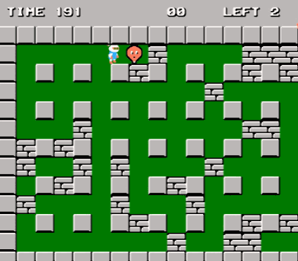
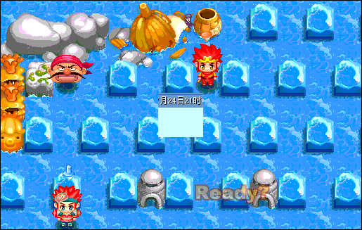
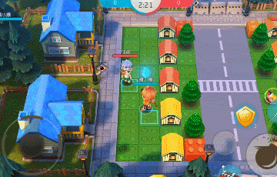
Features Flags
Modern Interface
Original
Our Target
IF WE HAVE TIME
AND STILL ALIVE
Notes:
First of all, we will design a modern interface for bombing adventure.
You can see in the original bomberman, it is already out of date.
Our target is in the middle. It looks more fancy and modern than the previous one.
The major difference between these two is that, in the modern interface, the blocks will be hidden when player moves.
AND… If we have time and still alive, we will improve our interface like this one.

Slide 10
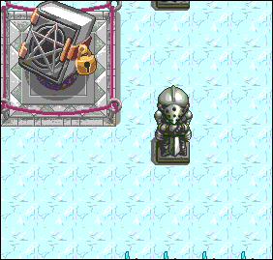
Features Flags
Level Design
Original
Our Target
Notes:
In the original bomberman, the map is fixed and you can only play games within this map repeatedly.
But we will design different levels and tasks in bombing adventure, you can move to the next level if and only if you kill all the computer players and complete specific tasks.

Slide 11
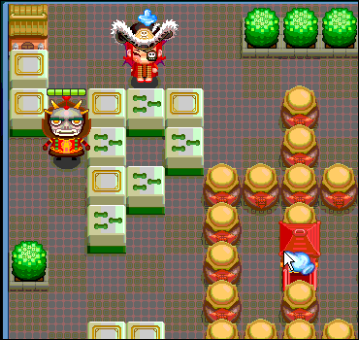
Features Flags
Network-based Multiplayer
Original
Our Target
Notes:
What’s more, we are going to add network-based multiplayer mode in bombing adventure.
You can choose either single-player mode or multiplayer mode before a game start. You can cooperate with your friend to adventure with the network.

Slide 12
04
Implementation & Plan
How are we going to do it?
What is our plan?

Slide 13
How are we going to do it? - Steps
M - Model
01
Logical implementation
01
Where to get them?
V - View
02
Video, sound, pictures…
02
03
C - Controller
03
04
Logical Perfection, Network
04
Testing
Notes:
So, how are we going to do it?
Basically our implementation follows the MVC design pattern, where M is model, V is view and C is controller. So our first three steps are M, V and C respectively.
Model is about logical implementation, or simply saying, how we design the core logical part of our project.
Next, View is about video, sound and pictures, etc. In this step we have a need to find proper external resources. Our solution is to get them by searching from the Internet, or necessarily designing them by ourselves.
Then, Controller is about logical perfection, we need to optimize our logic and connect them to other parts, and network, which is essential for our multiplayer mode.
In addition, we find testing is important for a successful game, so our final step of implementation is testing.

Slide 14

How are we going to do it? – Division of Labor
Logical Implementation
Network
Jingxuan QIU, Zhiyi ZHANG
01
04
Xuansu ZHANG, Zhiyi ZHANG
Video, Sound, Pictures…
02
05
Testing
Yang LIU, Xuansu ZHANG
Division of Labor
Yang LIU, Jingxuan QIU
03
06
Logical Perfection
Writing Report
Yang LIU, Jingxuan QIU
Yang LIU, Xuansu ZHANG, Zhiyi ZHANG, Jingxuan QIU
Notes:
We reorganize what we need to do, generate six steps and finish our division of labor.
We have three stages in general, and in different stages we have different divisions.
Stage 1 includes step 1 and 2, Stage 2 includes step 3 to 5, and Stage 3 is step 6.
In Stage 1, Zhiyi and I will finish logical implementation. Yang and Xuansu will finish the view part.
While in Stage 2, Yang and I will perform logical perfection and testing. Xuansu and Zhiyi will realize the network architecture.
Finally all of us will write the report together.

Slide 15
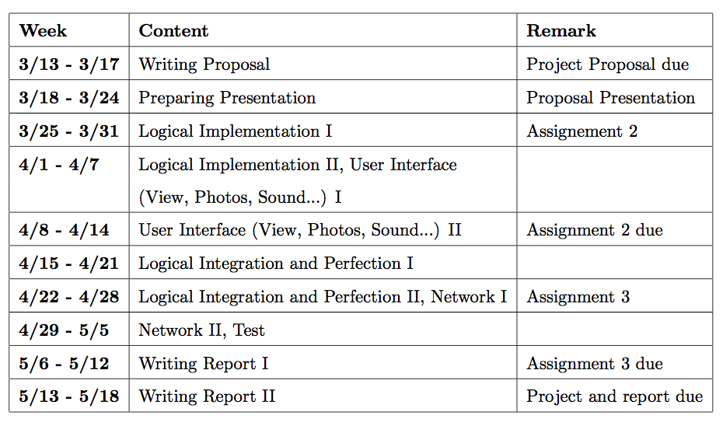
Milestones
Stage 1
Stage 2
Stage 3
Notes:
This is our schedule.
We have three weeks for stage 1, three for stage 2, and two for stage 3.
Our division of labor and milestones are subject to change based on practical needs.
But our general rule is to make sure all group members make the same contribution.

Slide 16
Thank you
Notes:
That’s all. Thank you.

